Slide 1
Credit EDA Case Study
Submitted By:
Alex Anthraper & Amit Haldar

Slide 2
Business Objectives:
Analysing the patterns in the consumer and loan application data using EDA for ensuring, whether or not, the applicants are capable of repaying the loans and are not rejected
To identify patterns indicating difficulties in paying instalments because of: - Denying the loan, reducing the amount of loan, lending (to risky applicants) at a higher interest rate - In other words, the company wants to identify and understand the driving factors (variables) an indicators for possible loan defaults

Slide 3
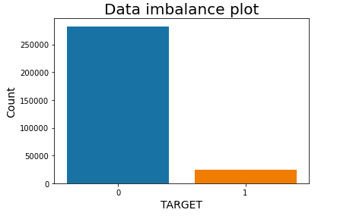
Data imbalance
The plot shows a clear imbalance between the values of the target variable

Slide 4
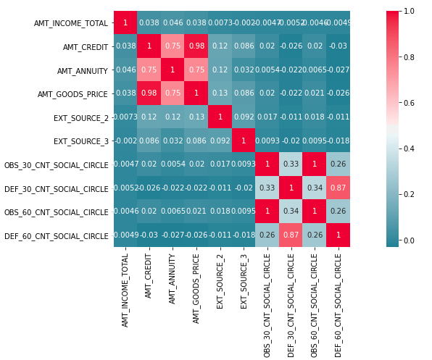
correlation
Correlation plot between selected variables

Slide 5
Univariate analysis

Slide 6
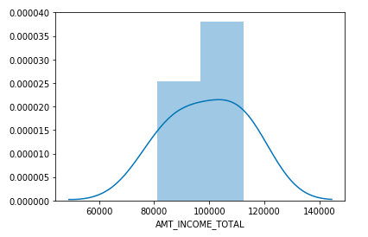
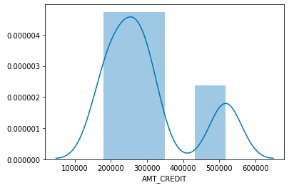
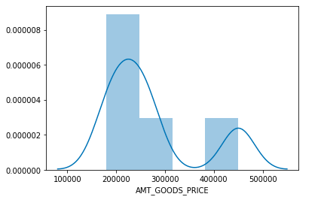
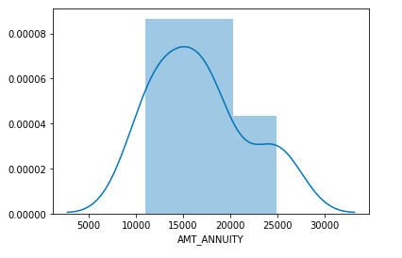
Numerical variables

Slide 7
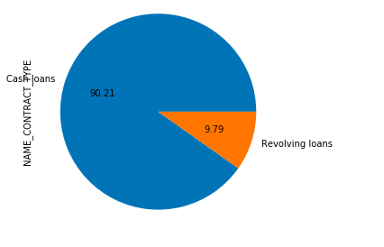
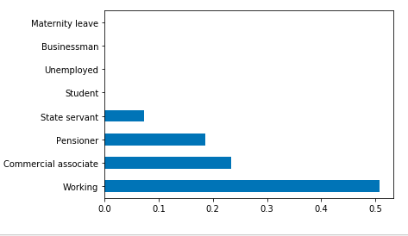
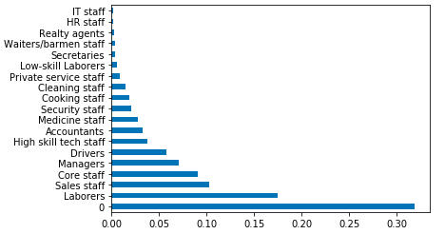
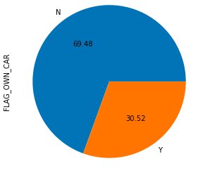
categorical variables

Slide 8
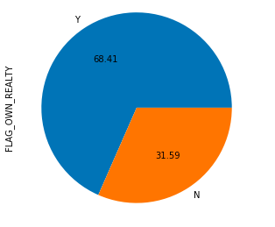
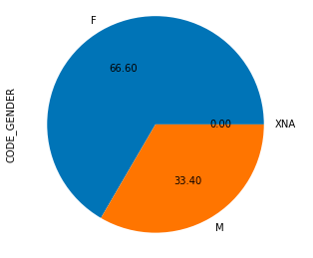
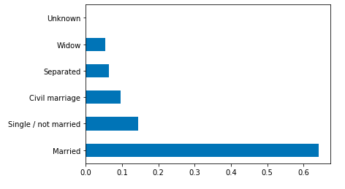
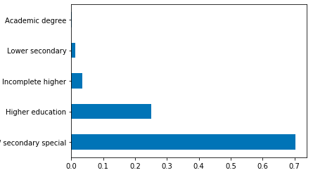
categorical variables

Slide 9
bivariate analysis

Slide 10
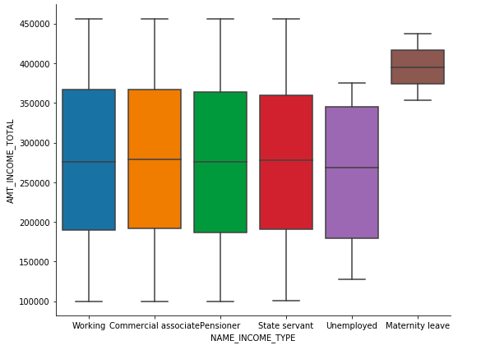
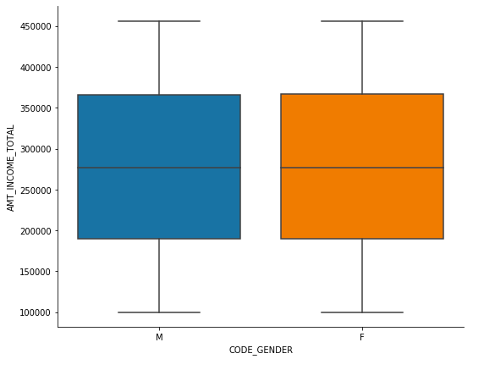
categorical variables
Income distribution among income types
Income distribution among genders

Slide 11
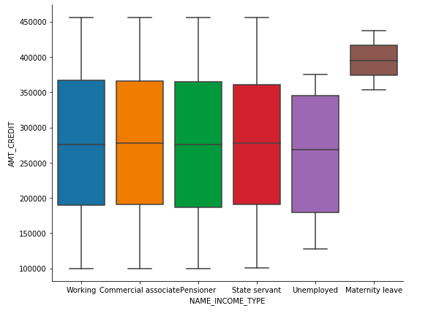
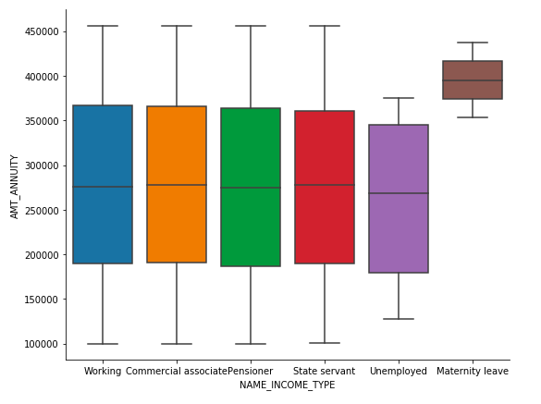
categorical variables
Credit distribution among income types
Annuity distribution among income types

